Slide 1

AI Vision Assistant for Visually Impaired Users
COMPUTER VISION ITA0502
PROGRAM DIRECTOR:
Dr. SASI REKHA
PROF/CSE
PRESENTED BY:
SRI HARI N (192572127)
G CHANDRA SEKHAR REDDY(192472173)
P.POORNA CHANDRA (192472287)
MEGHARAJU AKHILKUMAR (192572060)
KATHIKEYAN U (192572131)
FACULTY
Dr . R C . JENI GRACIA
ASS PROF / CSE

Slide 2


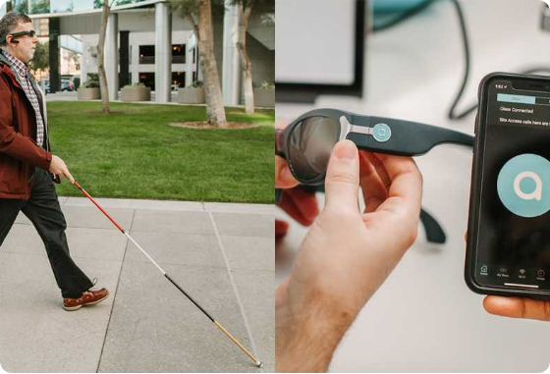
Agenda
Introduction to the AI Vision Assistant
Literature Review of Existing Solutions
Problem Statement & Objectives
System Architecture & Overall Design
Project Modules Overview

Slide 3
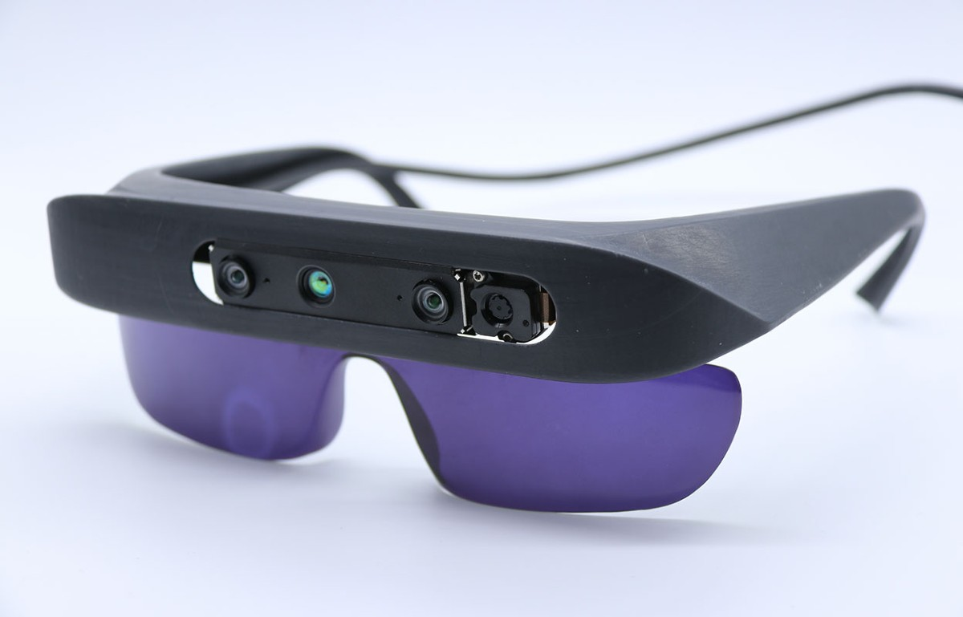
Introduction
Visual impairment creates challenges in navigation and accessing daily information.
Existing assistive tools often perform only one specific task.
This project integrates multiple AI features into a single intelligent assistant.
Uses Computer Vision, OCR, Speech Processing, and AI models.
Provides real-time voice guidance using a smartphone or webcam

Slide 4
Literature Review
S.No | Author(s) | Year | Title | Research Gap
1 | Bin Xiao et al. | 2024 | Florence-2: Advancing a Unified Representation for Vision Tasks | Focused on vision-language understanding but did not integrate obstacle detection, OCR, and navigation into a single assistive system.
2 | Rahima Khanam et al. | 2024 | YOLOv11: An Overview of the Key Architectural Enhancements | Improved real-time object detection but lacked voice guidance and accessibility features for visually impaired users.
3 | Ranjan Sapkota et al. | 2025 | A Comprehensive Review of the YOLO Object Detection Models | Reviewed YOLO advancements but did not propose an integrated AI assistant combining multiple assistive technologies.
4 | Cui et al. | 2026 | PaddleOCR-VL: Boosting Document Parsing Efficiency and Performance | Focused mainly on document OCR and parsing without navigation, object recognition, or scene understanding capabilities.

Slide 5
Problem Statement & Objectives
Visually impaired users rely on multiple applications for different tasks.
Switching between apps reduces efficiency and increases complexity.
Develop an integrated AI-powered vision assistant.
Provide real-time object detection, navigation, OCR, and currency recognition.
Deliver intelligent voice-based interaction for improved independence.

Slide 6
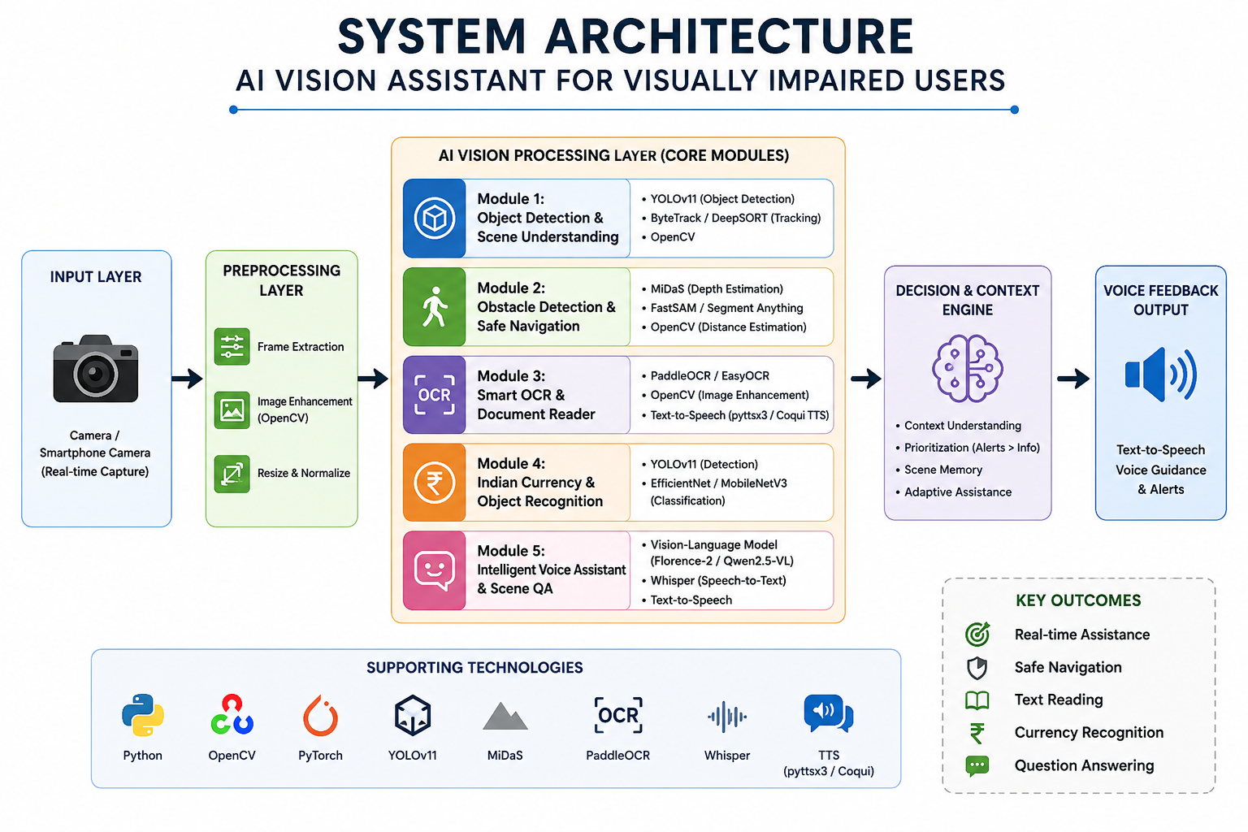

Slide 7
Modules Introduction
Module 1: Real-Time Object Detection & Scene Understanding
Module 2: Obstacle Detection & Safe Navigation
Module 3: Smart OCR & Document Reader
Module 4: Indian Currency & Essential Object Recognition
Module 5: Intelligent Voice Assistant & Scene Question Answering

Slide 8
Conclusion
Developed an AI-powered vision assistant that integrates multiple assistive technologies into a single platform.
Enables real-time object detection, obstacle avoidance, OCR, currency recognition, and scene understanding.
Provides voice-based guidance and natural interaction, improving accessibility and user independence.
Utilizes advanced AI models such as YOLOv11, MiDaS, PaddleOCR, Whisper, and Florence-2/Qwen2.5-VL for accurate and efficient performance.
Aims to enhance the safety, confidence, and quality of life of visually impaired users through intelligent, real-time assistance.

Slide 9


